Slide 1
START
START
START
Ready to read string from DTU via UART
Ready to read Hex command from STM32 via UART
Ready to receive input via MQTT
No
Receive Hex command?
No
Read string?
Receive input?
No
Yes
Yes
Yes
Read string
Receive Hex command
Receive input
If Hex command == ‘T_A1’ –’T_10F’
Yes
If string == ‘P/T_A1’ –’P/T_10F’
No
No
If Hex command == ‘P_A1’ –’P_10F’
Split input by ‘_’ delimiter and store into command[] array
If command[1] == “P”
Yes
No
Yes
Yes
Set modefrmsrvr = command[1]
Yes
If string == ‘T_ADT’ / ‘T_MDT’
Motor available?
Motor available?
No
No
No
No
If command[1] == “T”
Yes
Yes
Yes
If string == ‘stachck’
No
No
Motor ‘A1’ –’10F’ turns
Motor ‘A1’ –’10F’ turns
Yes
Write ‘stachck’ string to STM32 via UART
If Hex command == ‘ADT’
Drop sensor available?
No
Write temp. value and door status in string to DTU via UART
Retrieve temp. value and door status
Yes
sys.wait(3000)
No
No
Send 6 bytes of Hex command
Drop sensor available?
Write ‘modefrmsrvr_ command[2]’ string to STM32 via UART
If Hex command == ‘MDT’
Ready to receive return Hex
Yes
Ready to read string
No
No
Drop sensor available?
No
Receive return Hex?
Yes
Read string?
No
Yes
Drop sensor detects item?
No
Receive return Hex
Yes
read string
Send string value
DTU
STM32
sprintf ‘temp_door_drop_motor’ into a string
Send 5 bytes of return Hex
Send info to MQTT
STC BOARD

Slide 2

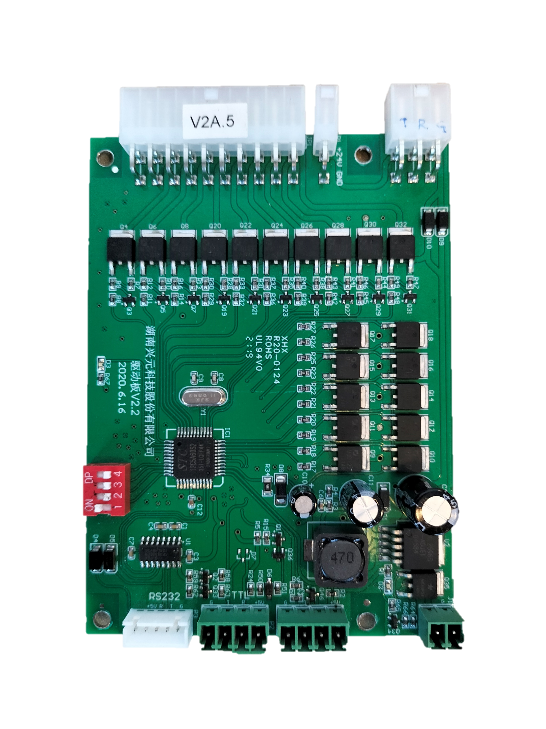
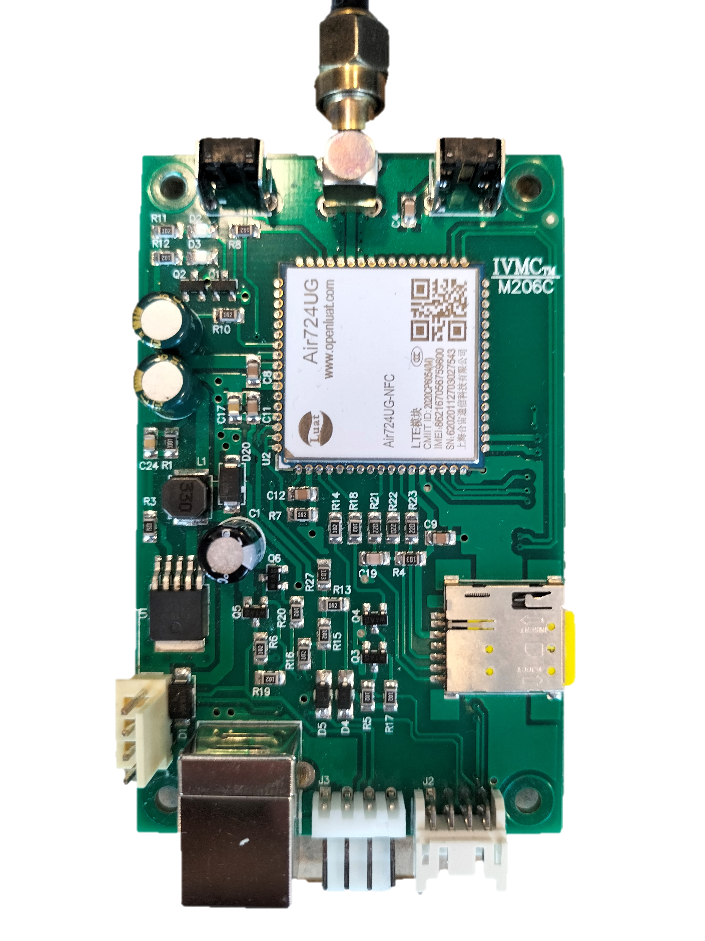
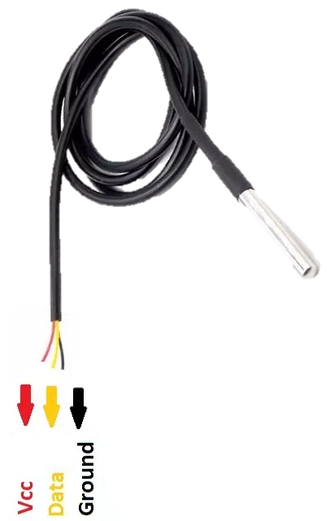
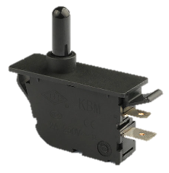
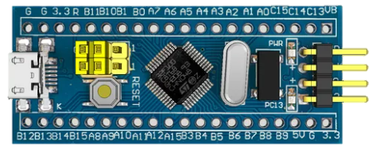
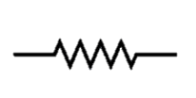
24V DC Power Supply
Motor Slots
Row
Column
24V
G
Drop Sensor
STC Board
DTU
Temperature Sensor
Drive
G
G
S
24V G R T
D
5V
G T R 5V
Drive
G T 5V
24V G
G
DS18B20
Door Switch
5V via micro-USB
STM32 Blue Pill
NO
C
4.7kΩ

Slide 3
List of Hex Commands and Returns https://docs.google.com/spreadsheets/d/1yvFmwiSHha0C8TX79S2l89XLynFGWwpFlRIR7rTtpHk/edit?usp=sharing

